Slide 1


HR Data Analysis Project: An Overview
This project enhances HR decision-making. We leverage data for actionable insights. The data sources include employee records and performance reviews.
We used SQL, Python, and Power BI. We focused on employee turnover and satisfaction. We also looked at performance and compensation ratios.
by Mahmoud Elfouly

Slide 2
business questions:
General Questions About the Data:
What is the total number of employees in the company?
How many employees are currently active?
What is the attrition rate?
What is the age of the youngest employee in the company?
What is the age of the oldest employee in the company?
Questions About Job Distribution:
In which departments are the active employees working?
Which department has the highest number of employees?
Questions About Hiring and Attrition:
How has the number of employees changed over the years?
How has attrition been distributed over the years?
Is there a correlation between age and attrition rate?
Questions About Demographics:
How are employees distributed by gender?
What is the distribution of employees by education level?
Which age group has the highest attrition rate?
Questions About Job Satisfaction and Salaries:
Is there a relationship between salary levels and attrition rate?
Which job categories have the highest attrition rates?
Does the attrition rate differ between males and females?
Does job satisfaction level affect attrition rates?

Slide 3
Data with SQL
SQL Role
Data Cleaning
SQL extracts, cleans, and transforms raw HR data.
We handled missing and duplicate values.
I used mySQL server with an HR schema. Queries included:
Employee demographics
Performance ratings
Attrition analysis

Slide 4
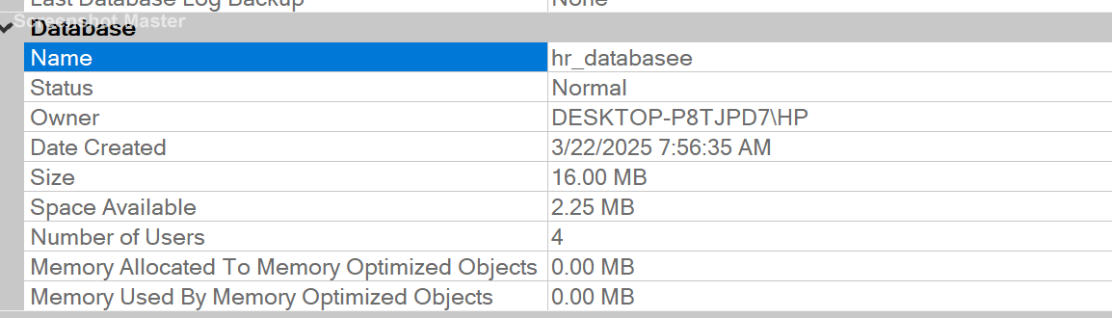
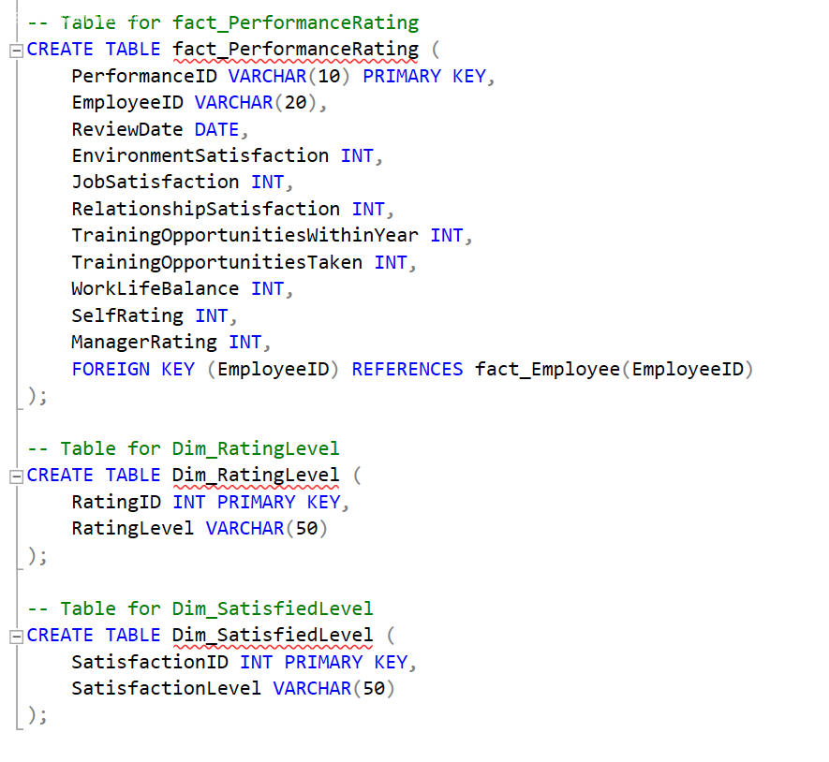
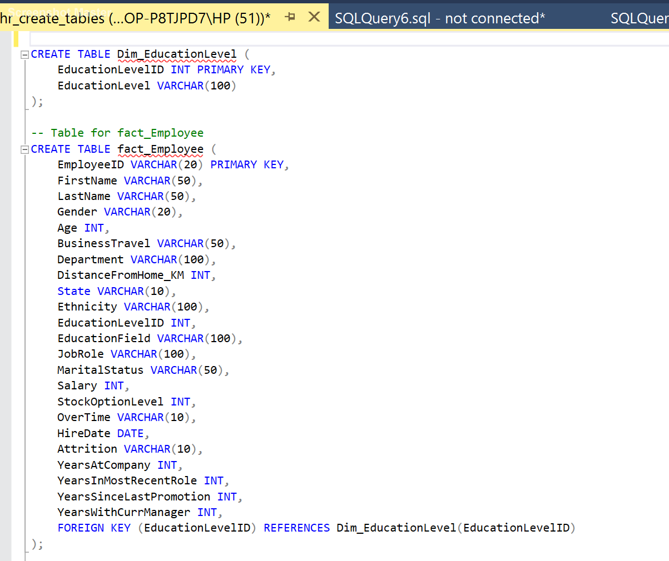
Create Database&Tables With SQL:

Slide 5
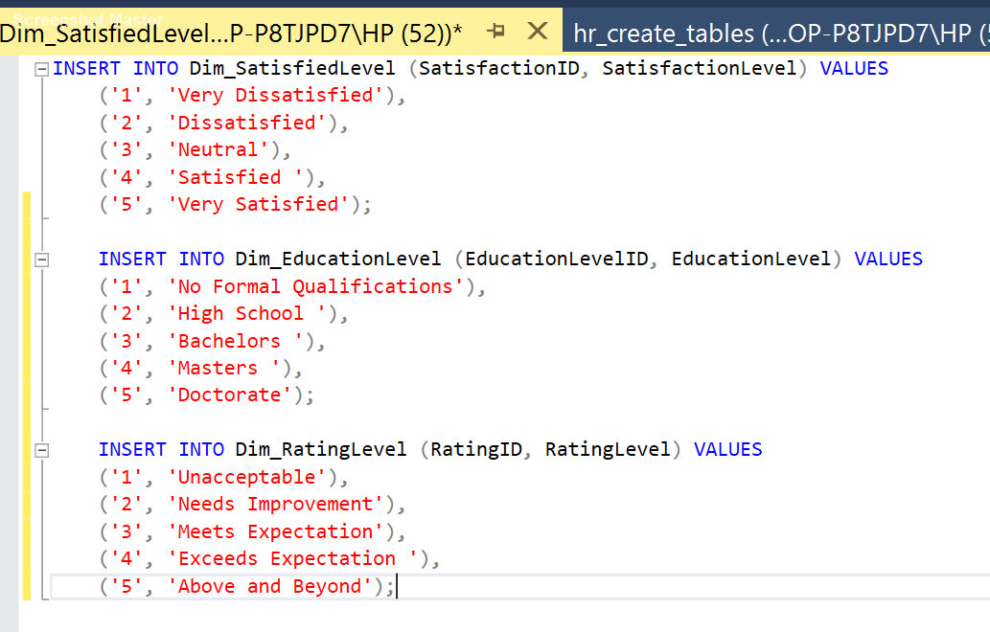
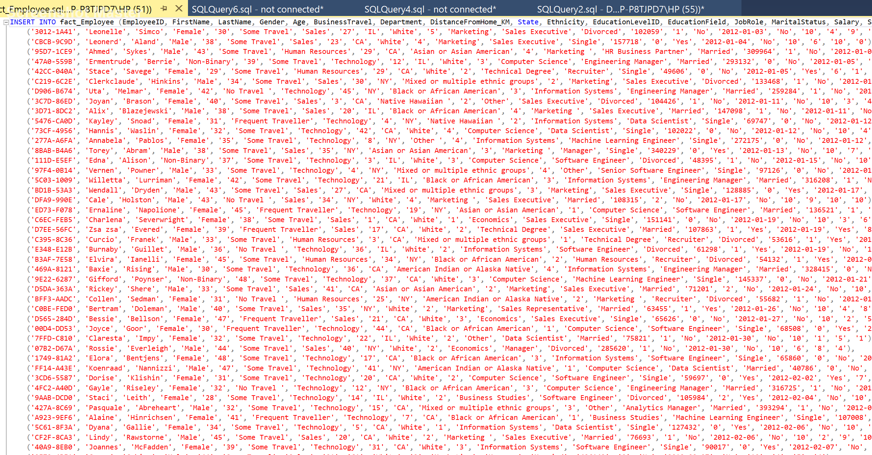
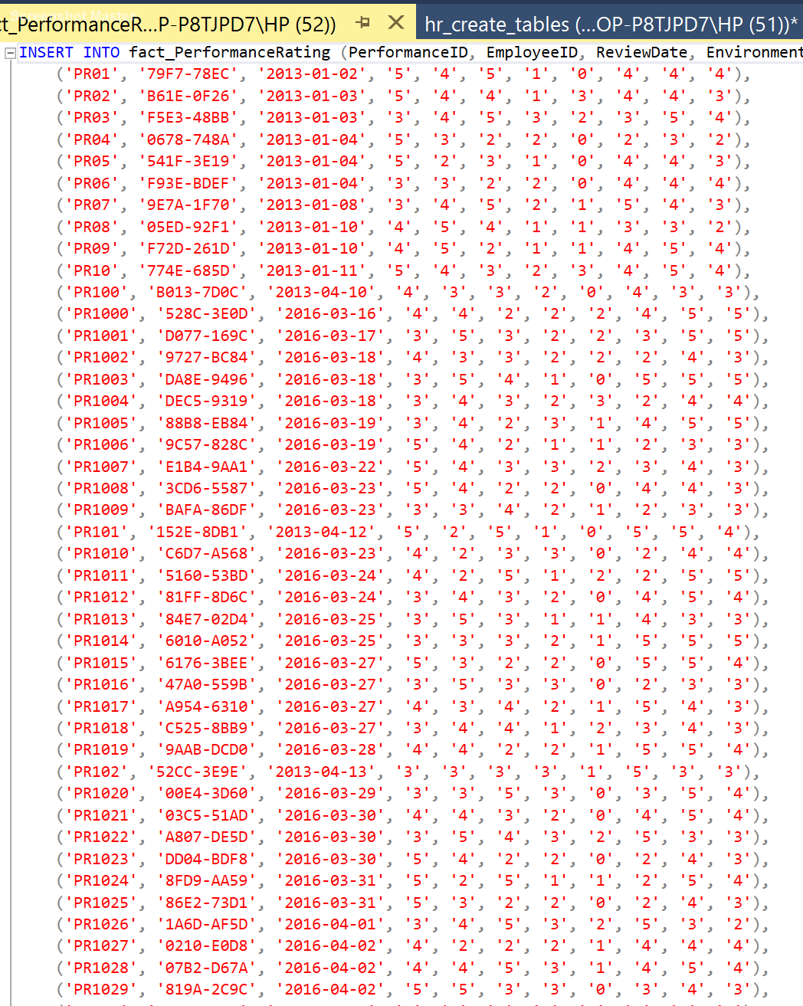
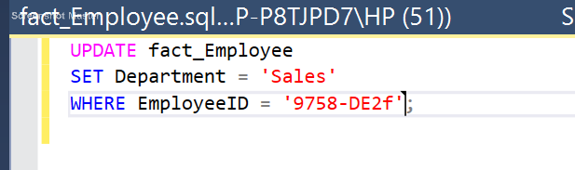
Insert&update (SQL):
Update employee data:

Slide 6
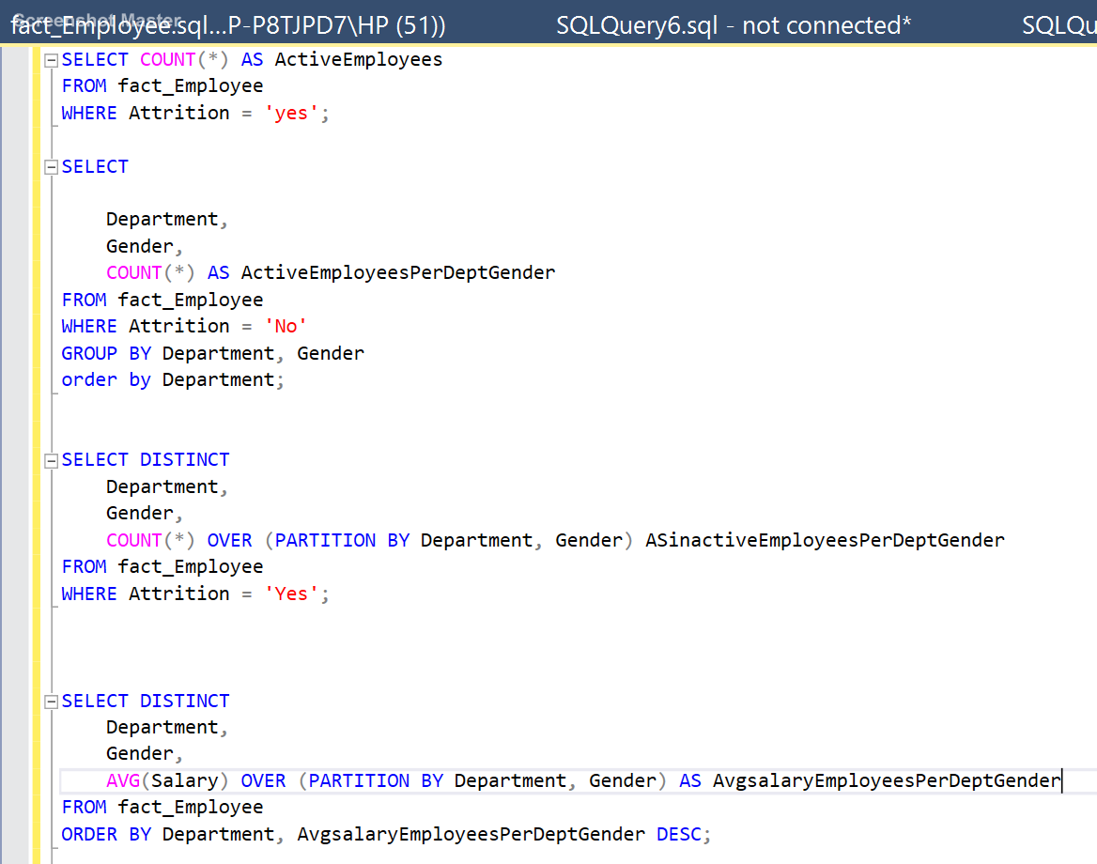
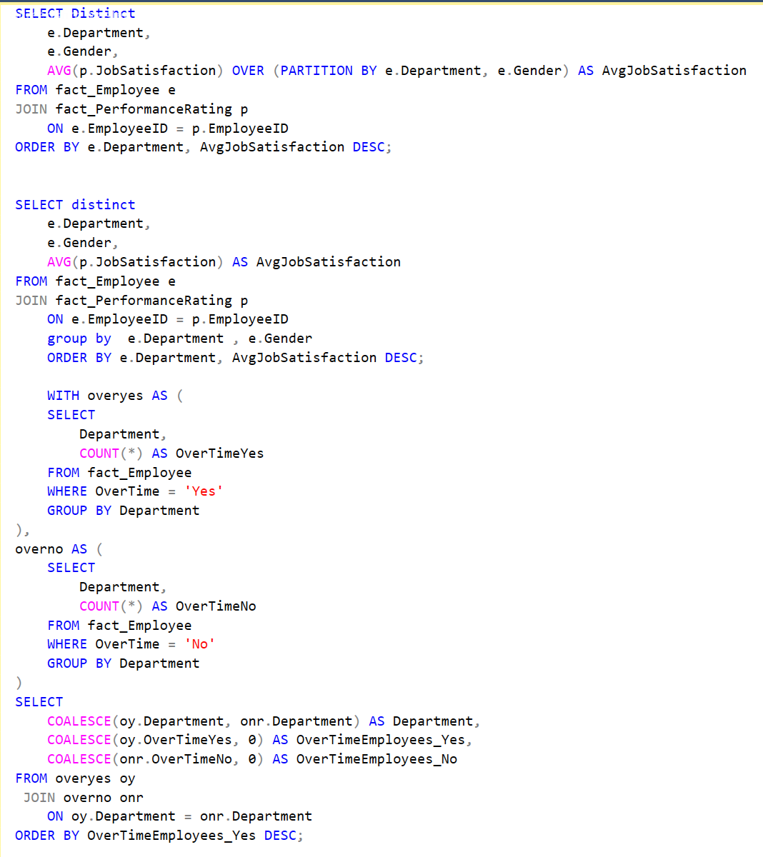
Queries:
Overview

Slide 7

Python for Advanced Analytics
Python's Role
Key Libraries
We performed statistical analysis and predictive modeling.
Pandas
NumPy
Plotly.express
Matplotlib
Seaborn
Data Loading
We read CSV into Pandas DataFrames.

Slide 8
What I did on python:
1. Data Ingestion Load the dataset into Pandas DataFrame using pd.read_csv() or pd.read_excel(). Inspect the first few rows with .head() to understand the structure.
2. Data Cleaning Handle duplicates by removing them using .drop_duplicates(). Manage missing values (NULLs) by either: Filling them with appropriate values (.fillna()). Removing incomplete records (.dropna()). Ensure data types are correct, converting columns if necessary (pd.to_datetime(), pd.to_numeric()).
3. Identifying and Correcting Data Errors Detected an issue: A Sales Employee was assigned to the wrong department. Fixed the issue by updating the department value using df.loc[]. Verified that the changes were applied correctly.
4. Initial Data Exploration with Visualizations Created quick exploratory visualizations to understand data distribution: Bar Charts for department-wise employee distribution. Pie Charts for gender and attrition analysis. Scatter Plots to explore relationships (e.g., Age vs. Salary). Used matplotlib and plotly to generate insights before deeper analysis.

Slide 9
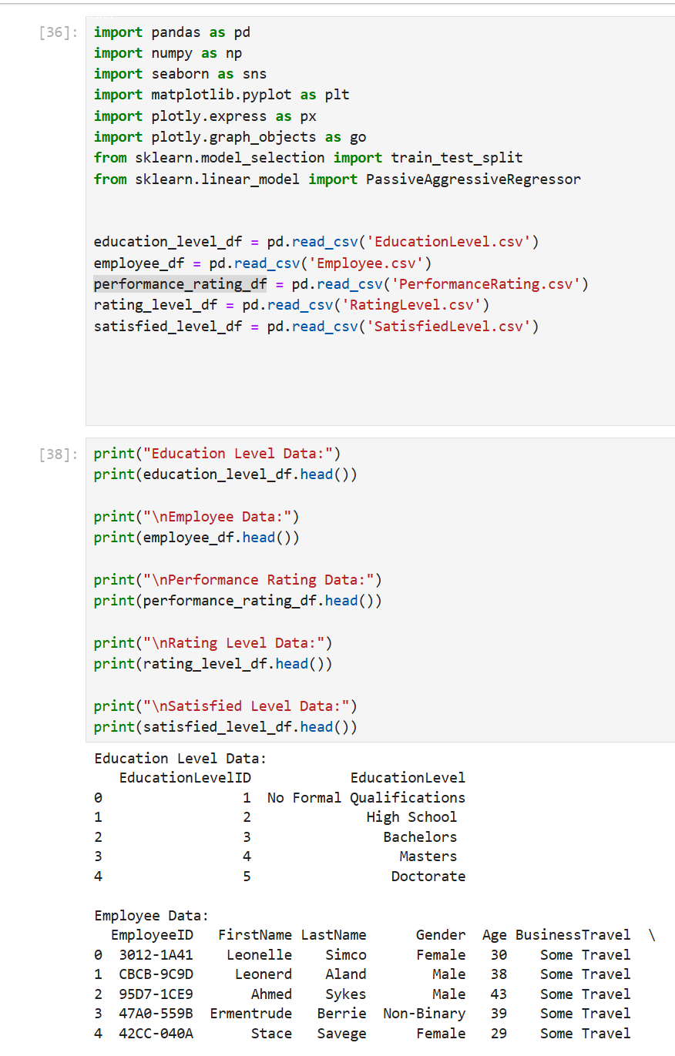
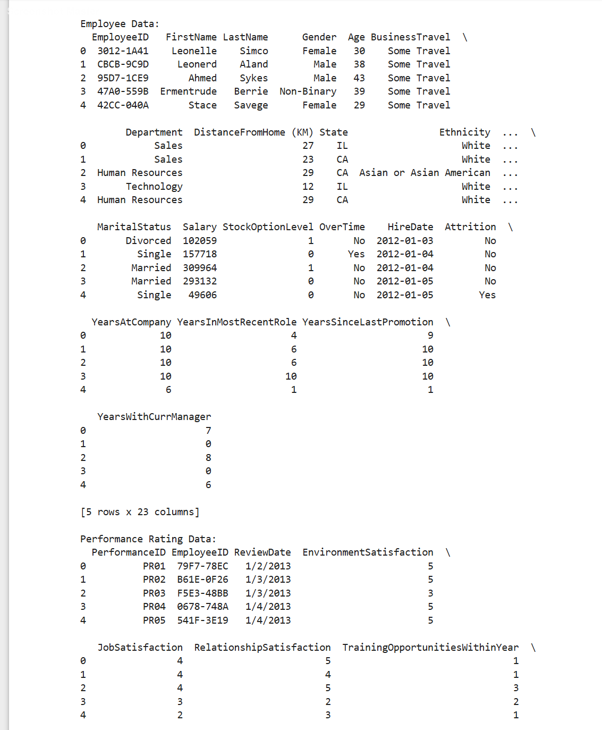

Slide 10
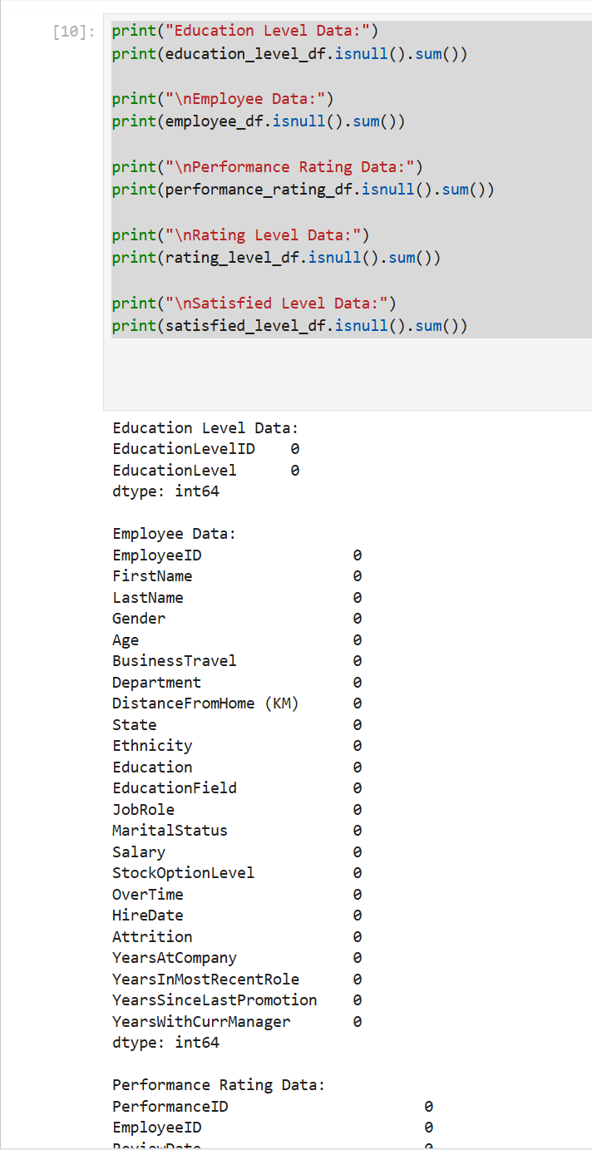
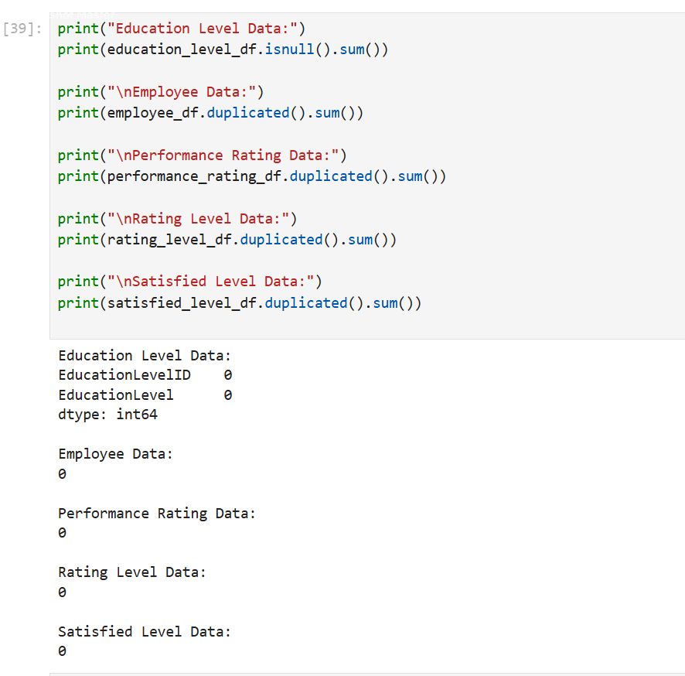

Slide 11
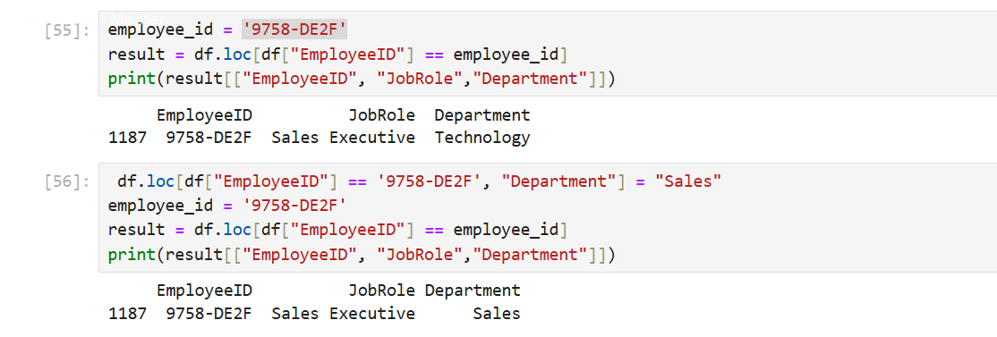
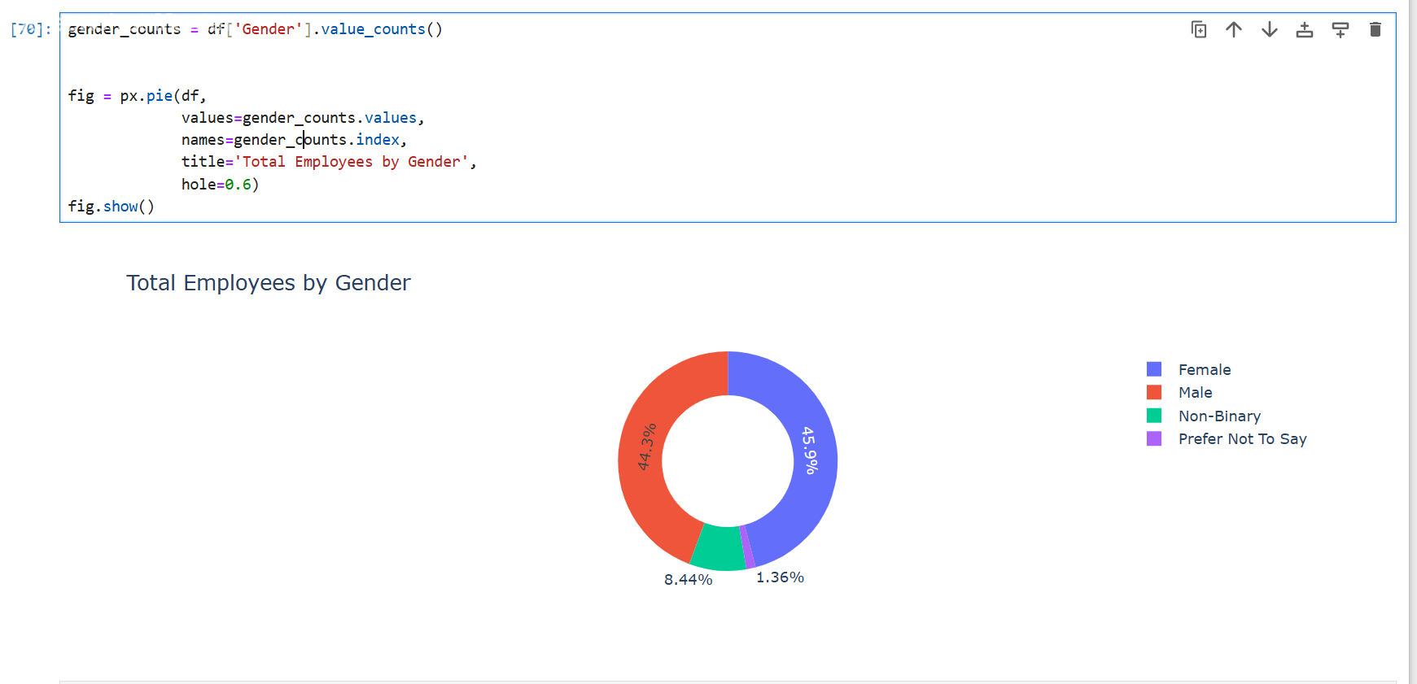

Slide 12
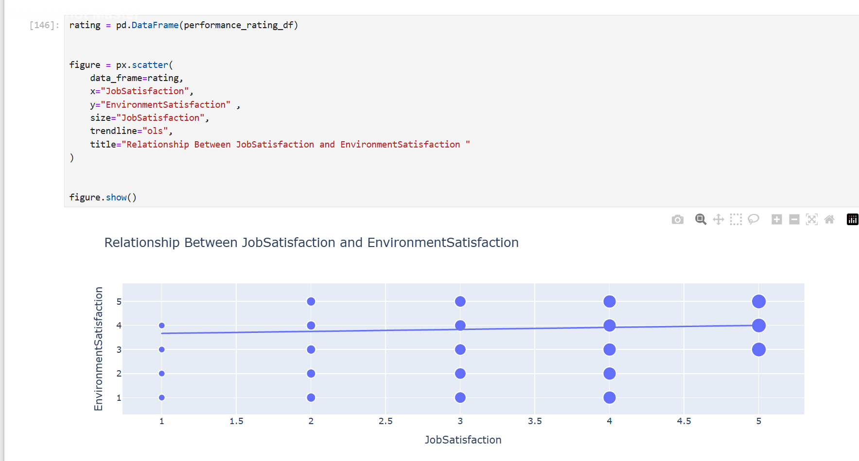
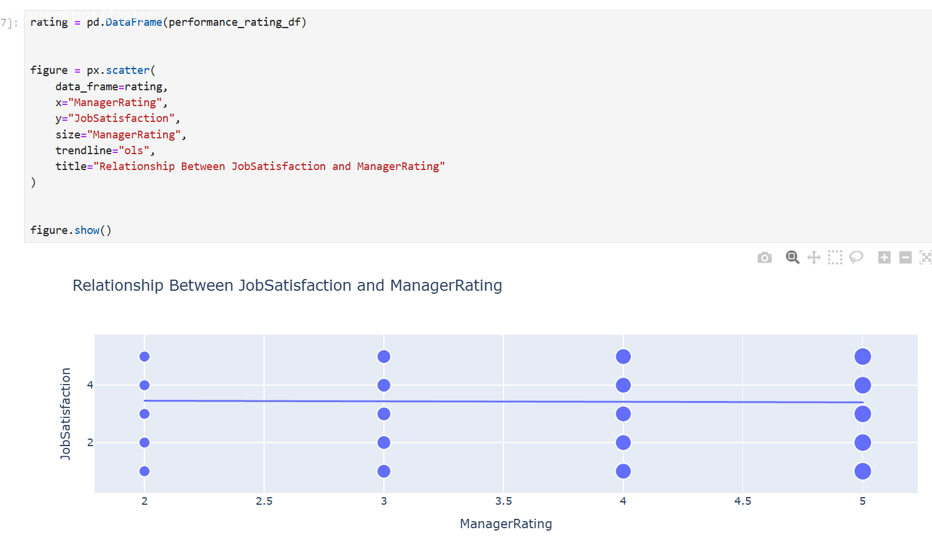

Slide 13
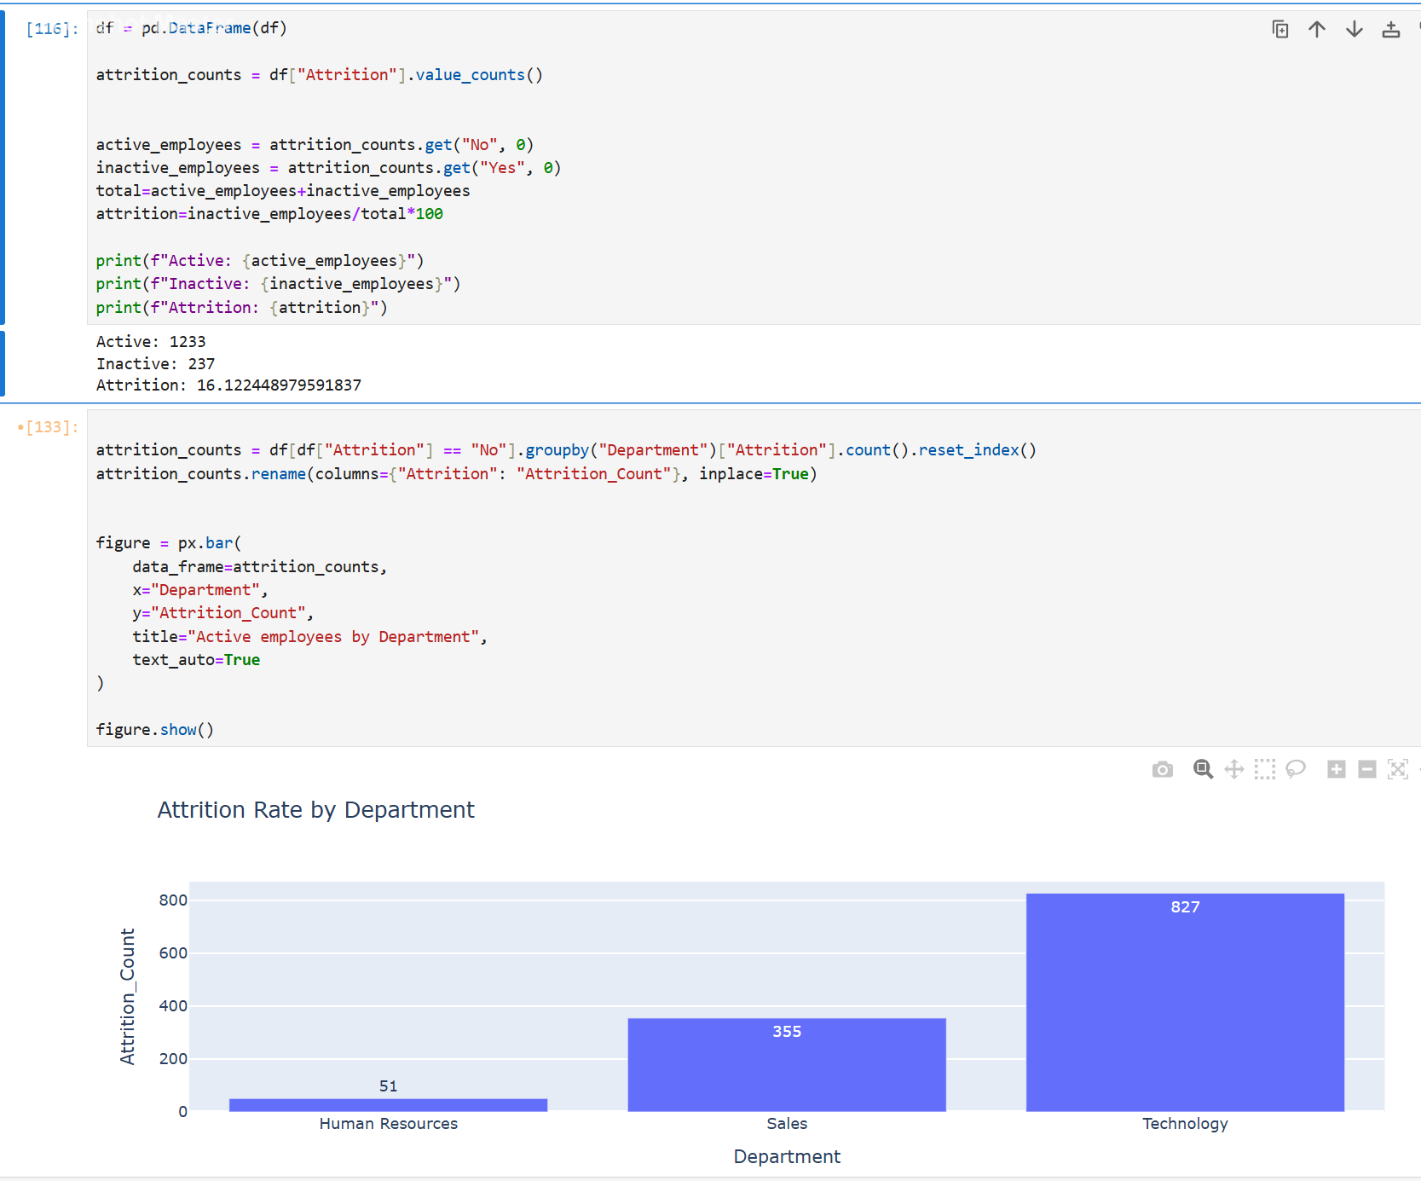
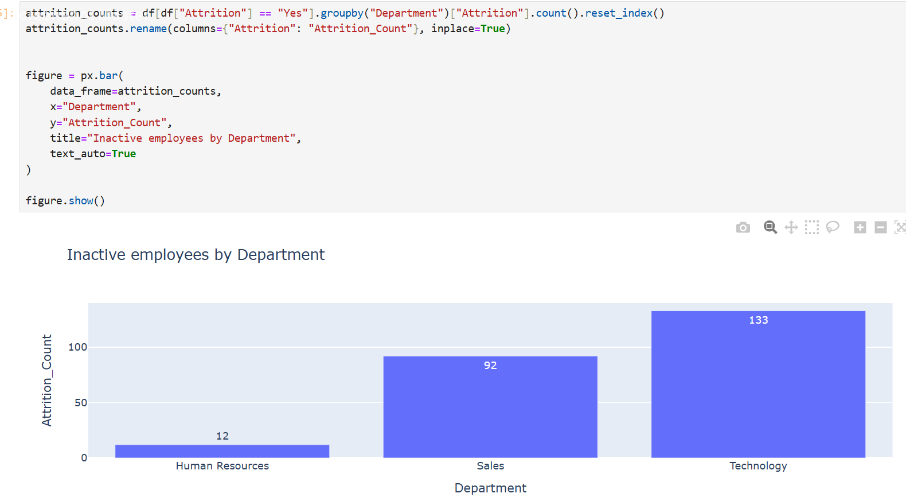

Slide 14



Data Visualization with Power BI
Connecting to Data
2
We imported data from Csv and SQL Server and Python scripts.
Power BI's Role
1
We created interactive dashboards for HR stakeholders.
Dashboard Components
3
We used KPIs and interactive charts. We also used filters.

Slide 15
What I did in power bi
Creating a Date Table
Generate a Date Table to enable time-based analysis.
Use DAX functions like like calendar to create a continuous date range.
Add calculated columns for Year, Month, Quarter, Week, and Fiscal Year for easier time-based filtering.
Ensure the Date Table is marked as a Date Table to enable time intelligence functions
2. Creating a Full Name Column in the Employee Table Combine the First Name and Last Name columns into a single Full Name column using DAX. Use the Combine() function or FirstName & " " & LastName to merge the values. Ensure proper formatting (e.g., handling missing values if applicable).
3. Creating an Age Group Column Define age categories by creating a calculated column in the Employee table. Use a SWITCH() or IF() statement to categorize employees into groups such as: "Under 25" "25-35" "36-45" "46 and above" Ensure that all employees are assigned to a relevant category.
4. Implementing DAX Measures for Analysis
Create DAX measures to analyze key performance metrics, such as:
Total Employees: Counting the number of active employees.
Attrition Rate: Percentage of employees who have left the company
Average Salary: Calculating the mean salary per department or age group. And more.
5. Validating Data and Relationships
Ensure all created columns and measures return the expected results.
Check relationships between tables (linking Date Table with Employee Hire Date).
Verify the accuracy of calculated columns through sample testing.
6. Preparing Data for Visualizations
Use newly created columns and measures in Power BI reports and dashboards.
Apply filters, slicers, and hierarchies for interactive reporting.
Optimize DAX calculations for performance efficiency by reducing unnecessary computed columns.

Slide 16
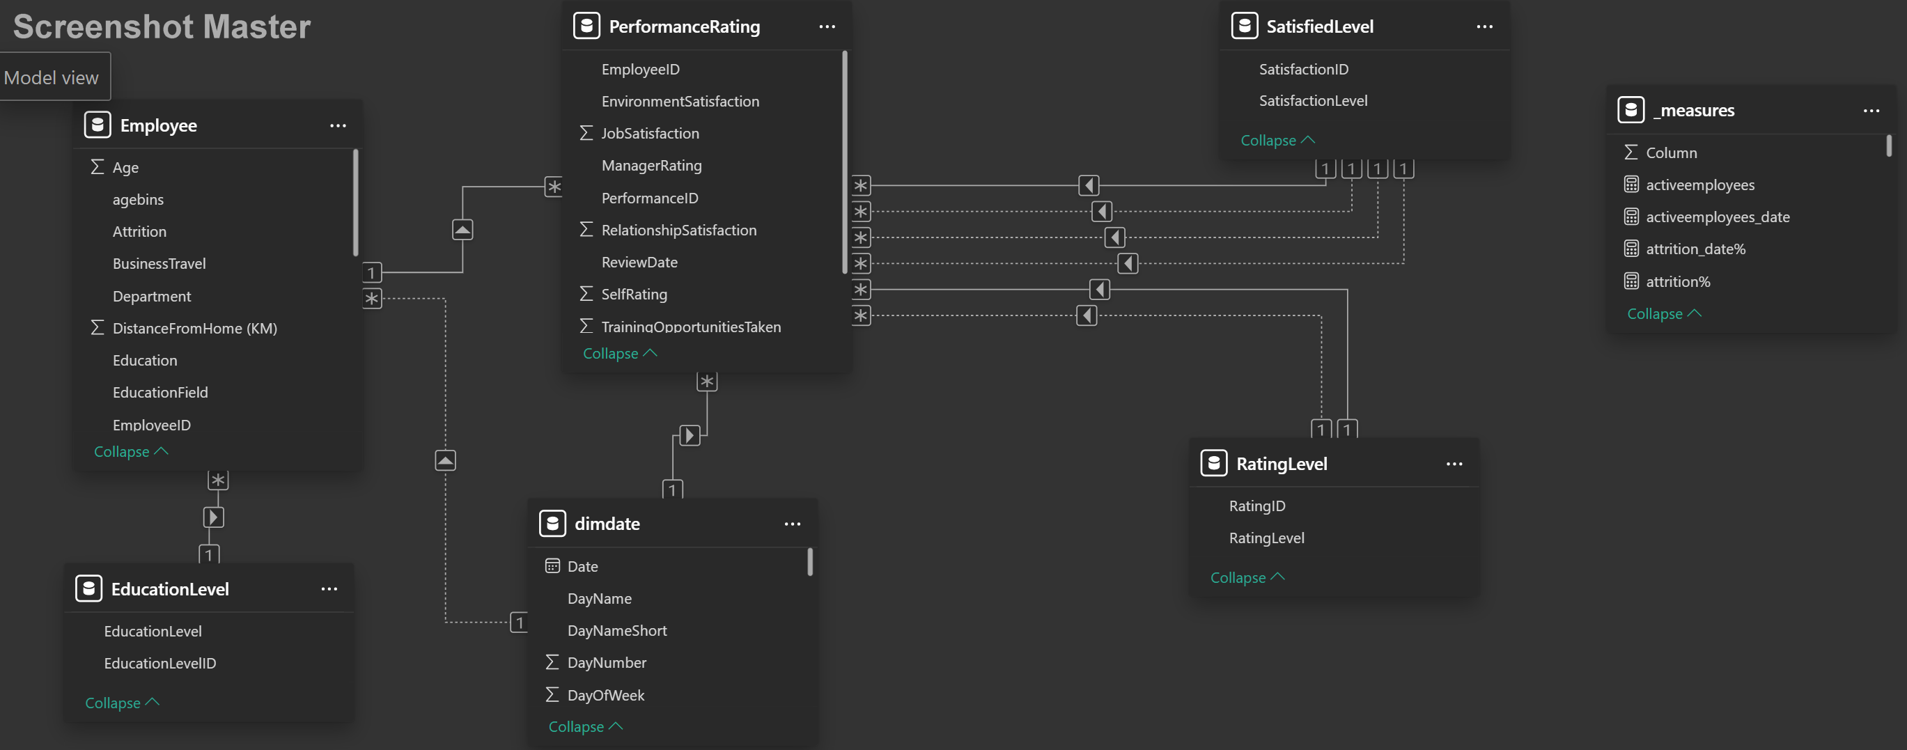
Data Modeling

Slide 17
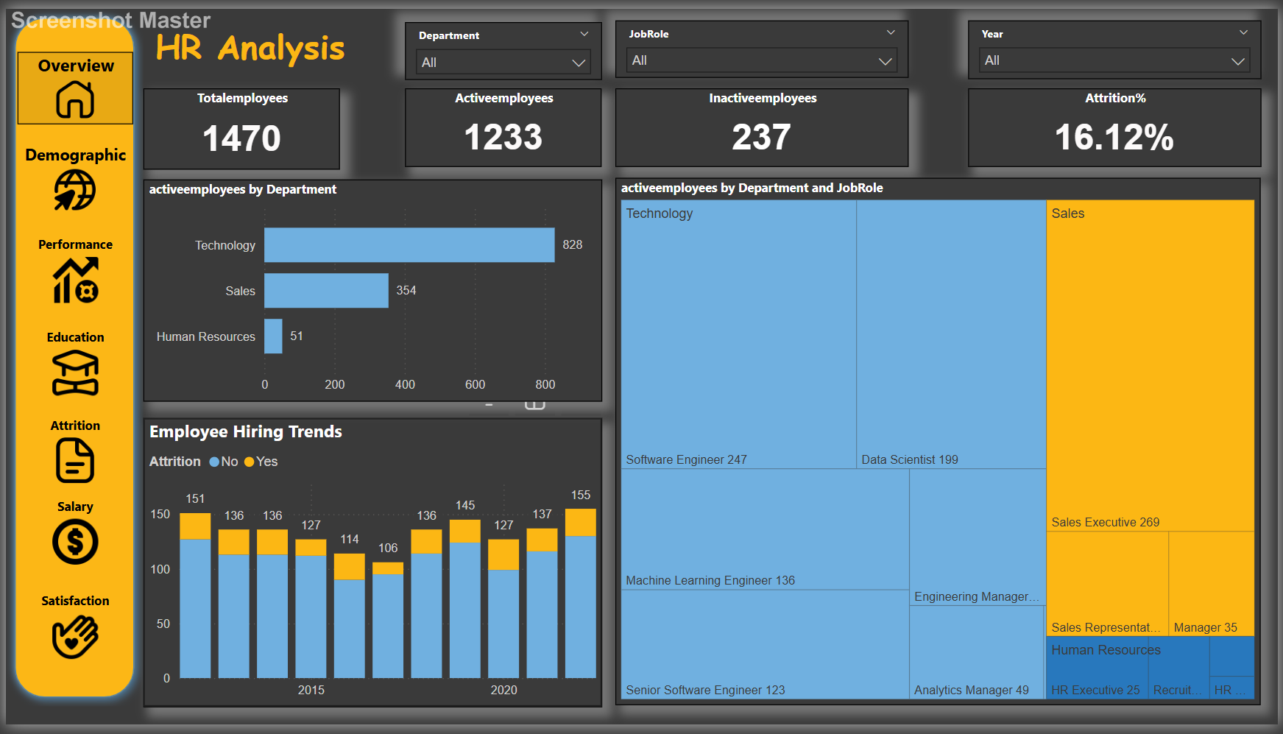
Interactive Dashboard
overview

Slide 18
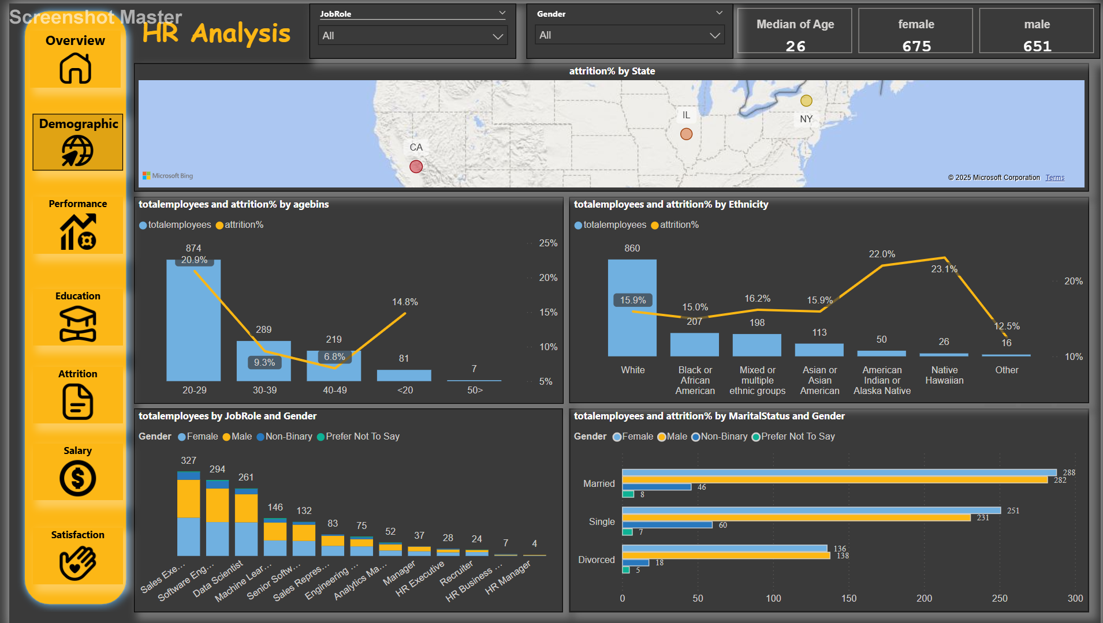
Demographics

Slide 19
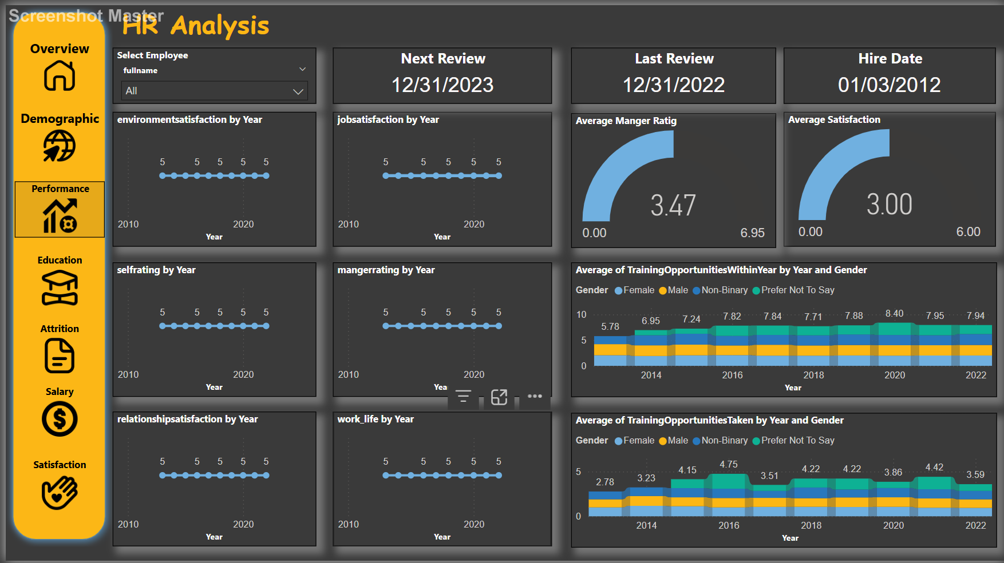
Performance

Slide 20
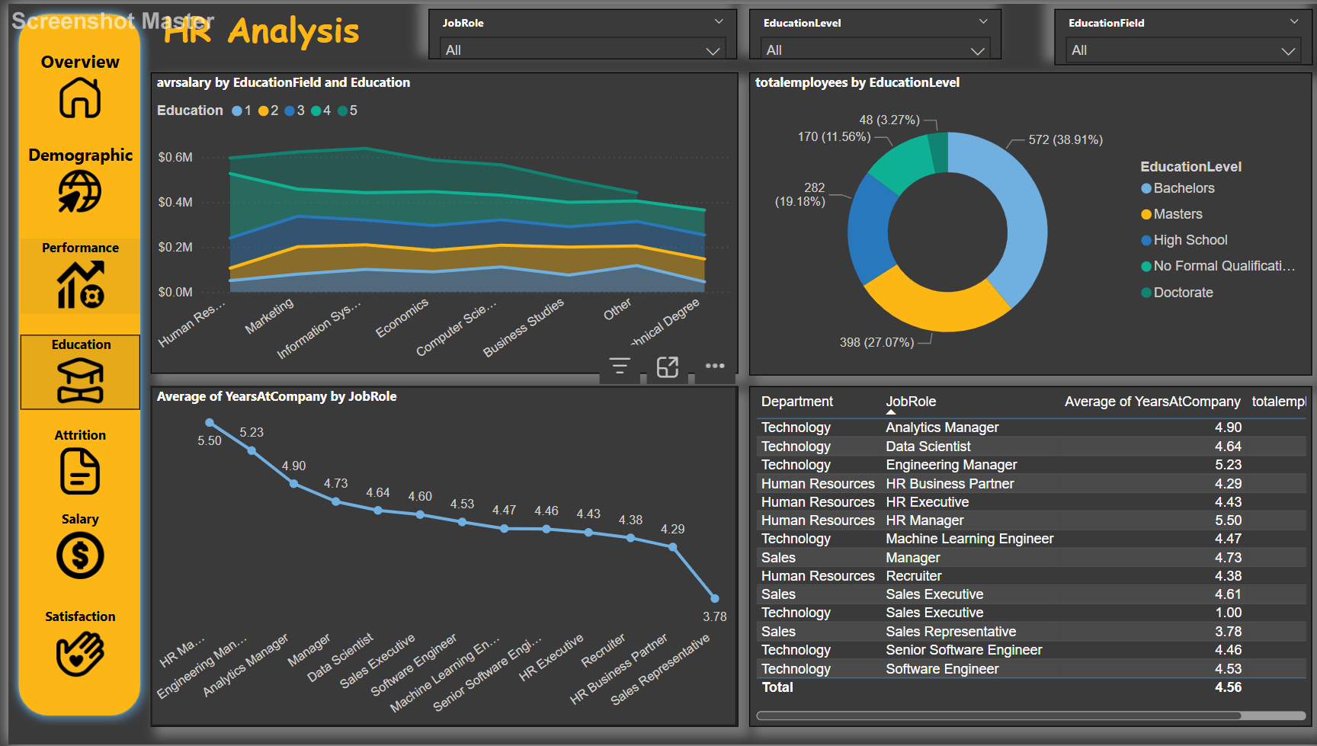
Education

Slide 21
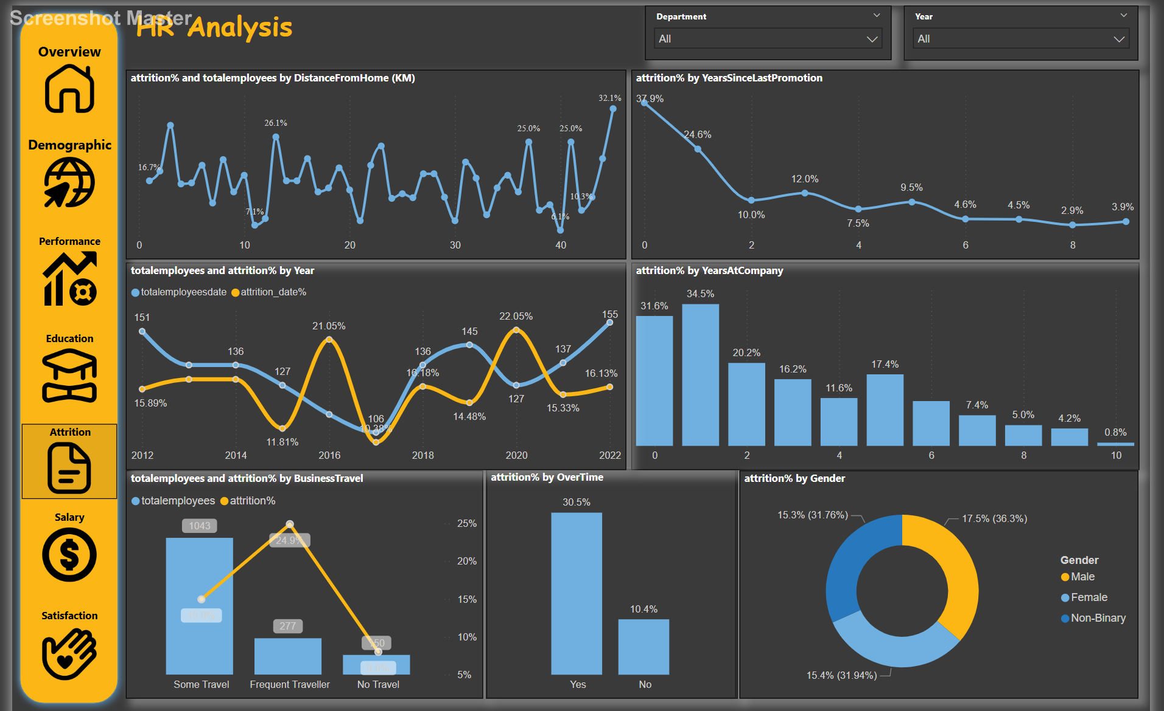
Attrition

Slide 22
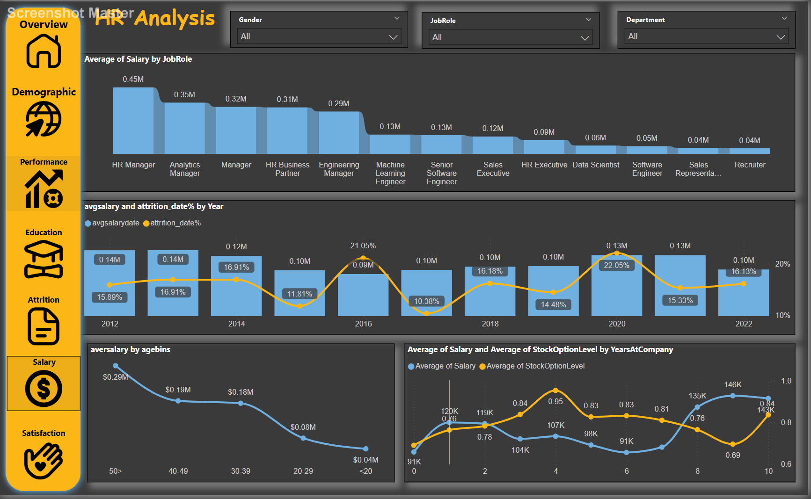
Salary

Slide 23
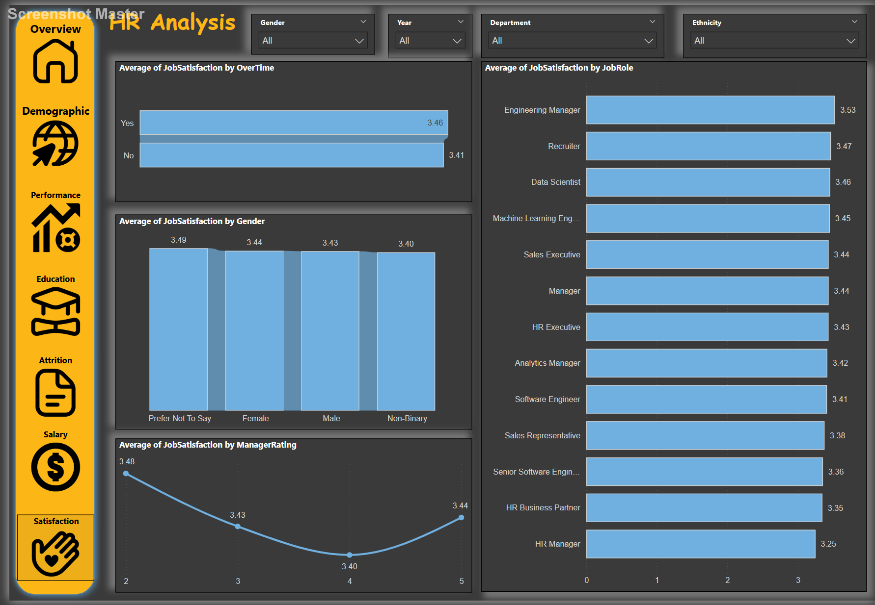
Satisfaction

Slide 24
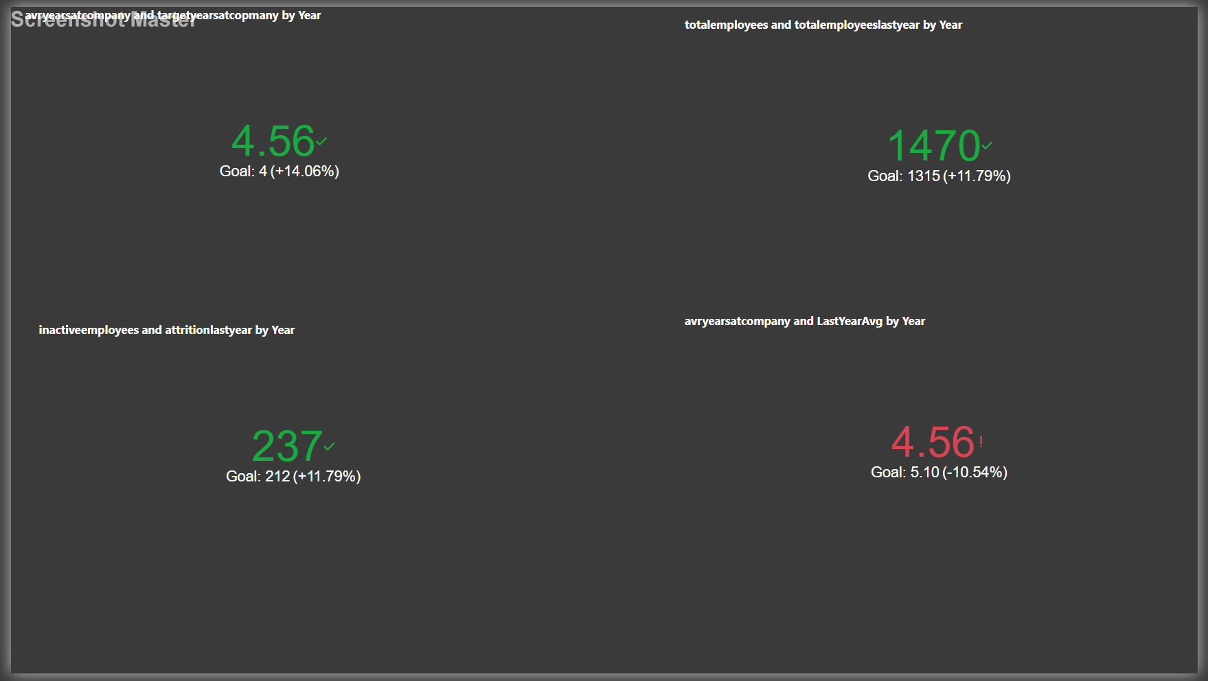
KPI

Slide 25

Project Recommendations and Insights
1. Reduce Attrition Rate
Identify Key Reasons for Attrition: Conduct exit interviews and employee surveys to understand why employees are leaving.
Enhance Employee Engagement: Offer career development programs, mentorship, and regular feedback sessions.
Improve Compensation & Benefits: Ensure competitive salaries and benefits compared to industry standards.
2. Improve Employee Satisfaction
Flexible Work Arrangements: Offer hybrid or remote work options where possible.
Recognition & Rewards: Implement a performance-based reward system to motivate employees.
Work-Life Balance: Encourage breaks, mental health programs, and reasonable work hours.
3. Address Demographic & Departmental Issues
Age & Career Growth: Provide skill development programs tailored to different age groups.
Gender Diversity: Ensure equal opportunities for growth and promotions across genders.
Departmental Focus: Identify departments with high attrition and address workload or leadership issues.
4. Data-Driven Decision Making
Predictive Analytics: Use HR analytics to forecast attrition and take proactive measures.
Employee Feedback Loop: Regularly collect and act on employee feedback.

Slide 26
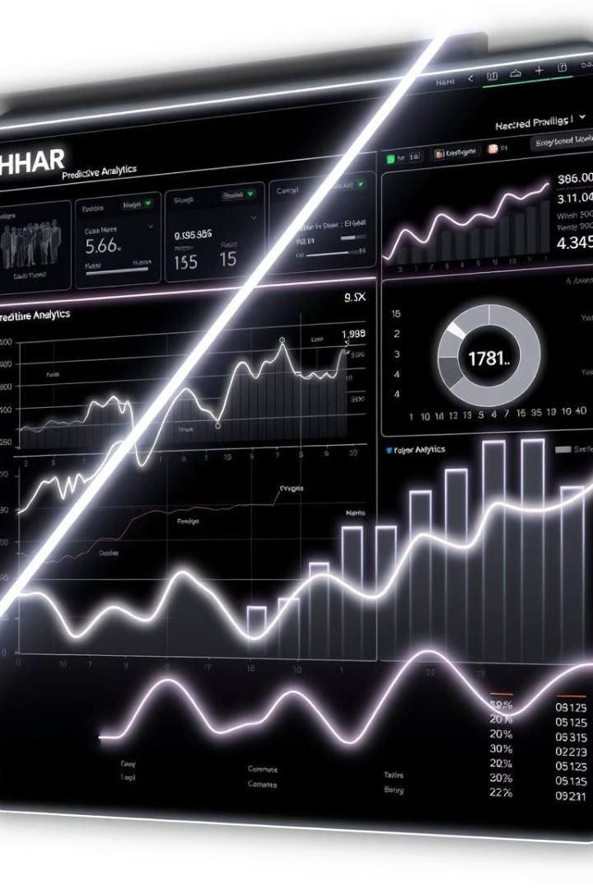
Conclusion and Future Steps
3
Data
Tools
Driven
Integrated SQL, Python, and Power BI.
Improved decision-making in HR.
Next
Steps
Continuous monitoring and advanced analysis.

